Slide 1

CoolTShirts Capstone
Learn SQL from Scratch
Andrew Nygren
6/18/2018

Slide 2
1.Getting to know CoolTshirts
1.1 Basic Layout
1.2 Number of Campaigns and Sources
1.3 Campaigns Related to Sources
1.4 Pages
2.User Journey
2.1 First Touch
2.2 First Touch Part 2
2.3 Last Touch
2.4 Last Touch Part 2
2.5 Total Purchases
2.6 Last Touch Purchases
2.7 Typical User Journey
2.8 Typical User Journey Part 2
2.9 Typical User Journey Part 3
3.Optimize the campaign budget

Slide 3
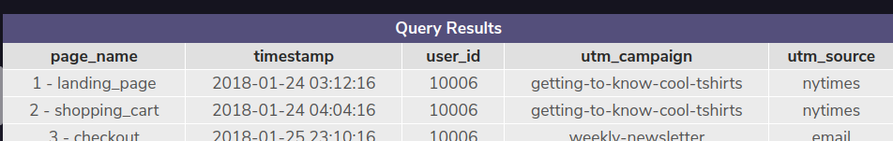
1.1 Getting to know CoolTshirts - Basic Layout
Using a * in a query will return all columns and rows from the page_visits table we can explore the The CoolTshits database.
Using the Limit function we can just return a few rows and find that we have 5 columns.
page_name
timestamp
user_id
utm_campaign
utm_source
SELECT *
FROM page_visits
LIMIT 10;

Slide 4
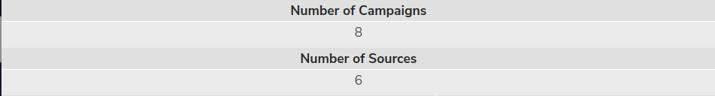
1.2 Getting to know CoolTshirts - Number of Campaigns and Sources
The utm_campaign is the type of ad that is being served to the user. The utm_source is the method of delivery. A campaign may be used on multiple sources.
We can find how many campaigns we have with the following query:
SELECT COUNT(DISTINCT utm_campaign) AS 'Number of Campaigns'
FROM page_visits;
And we can find how many sources we have with the following query:
SELECT COUNT(DISTINCT utm_source) AS 'Number of Sources'
FROM page_visits;
The count function will count the number of rows returned and the distinct function will limit the rows to (1) of each campaign or source. Therefore we will return (8) rows of distinct campaign values and count those (8) rows or (6) rows of distinct source values and count those (6) rows both using AS to alias their headers

Slide 5
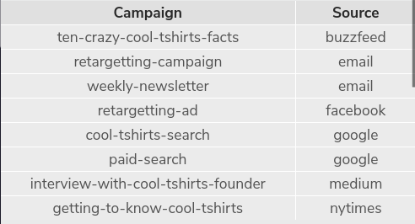
1.3 Getting to know CoolTshirts - Campaigns Related to Sources
We will see which campaigns were used by what source .
My first inclination was to select the campaign and source then group by the campaign. It gave me the correct results for the data supplied, but I realized that I would lose data if a single campaign was used on multiple sources. I thought that DISTINCT would do the same, but after testing I realized that it would return a distinct campaign for a distinct source. I ordered by the source so it would be sort of group together all the campaigns used on a single source
SELECT DISTINCT utm_campaign AS 'Campaign',utm_source AS 'Source'
FROM page_visits
ORDER BY 2;

Slide 6
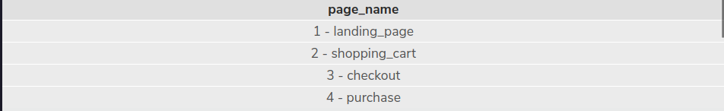
1.4 Getting to know CoolTshirts - Pages
Lastly we will find the different page names by limiting the results using the distinct function which will return (1) of each page name. We will find that there are four (4) pages.
SELECT DISTINCT page_name
FROM page_visits;

Slide 7
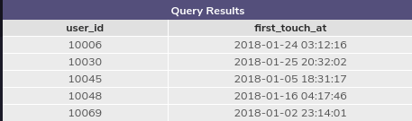
2.1 User journey - First touch
First touch will show us the first time someone visits the site. We can then use this to find out how they got there.
Using the “WITH” we will create a subquery named “first_touch” we will select the user_id, and using the “MIN” on the timestamp we will limit the results to the earliest time to be returned. Grouping by the user_id will limit the results to (1) of each user_id at the earliest time
WITH first_touch AS (
SELECT user_id,
MIN(timestamp) as first_touch_at
FROM page_visits
GROUP BY user_id)
This is an example of returned results by selecting all (*) from the first_touch subquery.

Slide 8
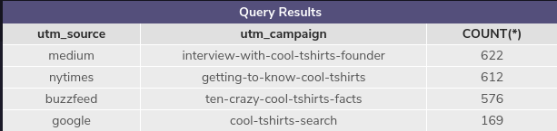
2.2 User journey - First touch Part 2
We can then use this subquery in our main query. We will select the utm_source and utm_ campaign and count the number of rows returned from the page_visits table. To limit this count to the first touch we will join the subquery to our page_visits table on the ft.user_id on pv.user_id and ft.first_touch_at on pv.timestamp. Grouping by the campaign will count up the rows returned per campaign of the joined tables. We ordered them by the count descending to see which campaigns were most successful.
WITH first_touch AS (
SELECT user_id,
MIN(timestamp) as first_touch_at
FROM page_visits
GROUP BY user_id)
SELECT pv.utm_source,
pv.utm_campaign,
COUNT(*)
FROM first_touch ft
JOIN page_visits pv
ON ft.user_id = pv.user_id
AND ft.first_touch_at = pv.timestamp
GROUP BY 2
ORDER BY 3 DESC;

Slide 9
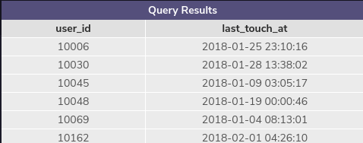
2.3 User journey - Last touch
To find the last touch count each campaign produced will be done in much the same way first touch campaign count was done.
Instead of using “MIN” to find the earliest time we will use “MAX” on the timestamp to limit the results to the latest time to be returned. Grouping by the user_id will limit the results to (1) of each user_id at the latest time.
WITH last_touch AS (
SELECT user_id,
MAX(timestamp) as last_touch_at
FROM page_visits
GROUP BY user_id)
This is an example of returned results by selecting all (*) from the last_touch table.

Slide 10
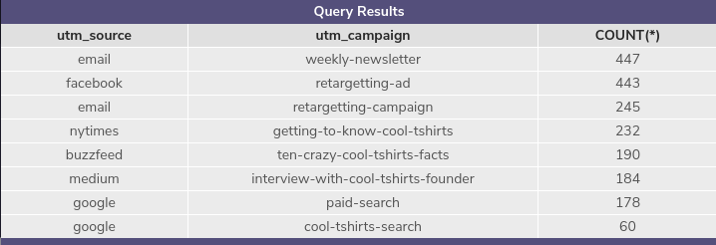
2.4 User journey - Last touch Part 2
As before We will join the subquery to the page_visits on the same points grouping and ordering the same way to achieve a total count per campaign.
WITH last_touch AS (
SELECT user_id,
MAX(timestamp) AS last_touch_at
FROM page_visits
GROUP BY user_id)
SELECT pv.utm_source,
pv.utm_campaign,
COUNT(*)
FROM last_touch lt
JOIN page_visits pv
ON lt.user_id = pv.user_id
AND lt.last_touch_at = pv.timestamp
GROUP BY 2
ORDER BY 3 DESC;

Slide 11

2.5 User journey - Total Purchases
Using the count function we can select count everything aliasing as “Purchases”, from the page_visits table and then limit the count to the those who landed on the purchase page using a where clause.
SELECT COUNT(*) AS ‘Purchases’
FROM page_visits
WHERE page_name = '4 - purchase';

Slide 12
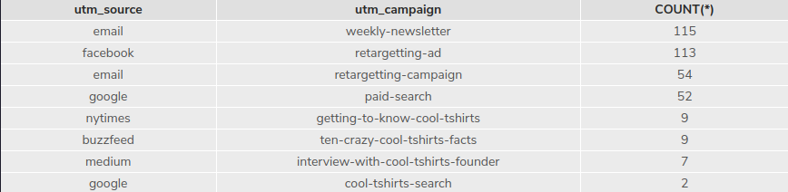
WITH last_touch AS (
SELECT user_id,
MAX(timestamp) AS last_touch_at
FROM page_visits
WHERE page_name = '4 - purchase'
GROUP BY user_id)
SELECT pv.utm_source,
pv.utm_campaign,
COUNT(*)
FROM last_touch lt
JOIN page_visits pv
ON lt.user_id = pv.user_id
AND lt.last_touch_at = pv.timestamp
GROUP BY 2
ORDER BY 3 DESC;
2.6 User journey - Last touch Purchases
Using our code from the last touch, we can add a where clause to our subquery to limit the returned results to those who made a purchase.

Slide 13
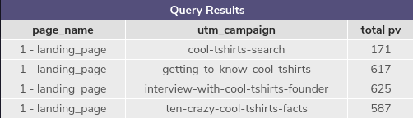
2.7 User Journey - Typical User Journey
The typical user journey seems to me to be how most users get to the pages. So I decided to find out the MAX number of users a utm_campaign generated per page. I started out by making a subquery that would give the number of users visiting a particular page per campaign.
WITH fpv AS(
SELECT page_name,
utm_campaign,
COUNT(*) AS 'total pv'
FROM page_visits
WHERE page_name like '1%'
GROUP BY 2)
I made one of these for pages 1-4. We name the subquery for the page we are counts for, select the page name, campaign and count alias “total pv”. Taking the data from the page visits table, limit by the name, group by the campaign and count the totals.

Slide 14

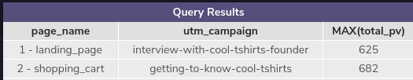
2.8 User Journey - Typical User Journey Part 2
On the second part of our query we will select the page name, campaign, and The MAX total pv. This will give us the largest number of those totals.
SELECT page_name,
utm_campaign,
MAX(total_pv)
FROM fpc
If we do this for each page we will get 4 seperate results. We can use UNION to bring these all together into one query.
SELECT page_name,
utm_campaign,
MAX(total_pv)
FROM fpv
UNION
SELECT page_name,
utm_campaign,
MAX(total_pv)
FROM spv

Slide 15
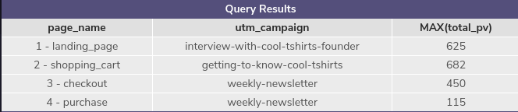
2.9 User journey - Typical User journey Part 3
Bringing these all together we can see how most people landed on a page through what campaign.
And so I conclude that a typical user journey starts with the campaign
Interview with cool tshirts founder
Getting to know cool tshirts
Weekly Newsletter
Weekly Newsletter

Slide 16
3 Optimize the campaign budget
If I were to recommend what campaigns to reinvest in, I would recommend the following:
Interview with cool tshirts founder
Getting to know cool tshirts
Ten crazy cool tshirt facts
Weekly newsletter
Retargeting ad
I would recommend these because the had very high first touch and last touch results, driving the most traffic to the website, and most likely to result in a purchase.

